Slide 2
H Woodhead
Head of Year 8

Slide 4
A Rahman
Assistant Headteacher

Slide 5
Year 9

Slide 6

Year 9 - A Hybrid Model
Year 9 is a blended year
Teachers begin to expose students to the skills and rigour of Key Stage 4, whilst still ensuring the curriculum is:
  Broad and Balanced
  Relevant
  Challenging
  Enjoyable
  Personalised
Students in Year 9 are given a choice of some subjects they would like a taster of

Slide 7
Year 9 - A Hybrid Model
The time allocation for Science increases to better prepare students for the different pathways available in GCSE Science
History and Geography increase by one lesson
Possibility for some students to study Spanish after school
This blend between KS3 and KS4 allows students to truly appreciate their chosen subjects, and helps students make a better informed set of option choices to study as part of their GCSE’s in Years 10 and 11.

Slide 8

Year 9 - Core Curriculum
English (Language and Literature)
Maths
Science (Biology, Chemistry, Physics)
Geography
History
Computing
RE
PE (core)
MFL*

Slide 9

Year 9 – Optional subjects (Max 3)
Art
Dance
D & T
Drama
Food
Music
PE (theory)

Slide 10
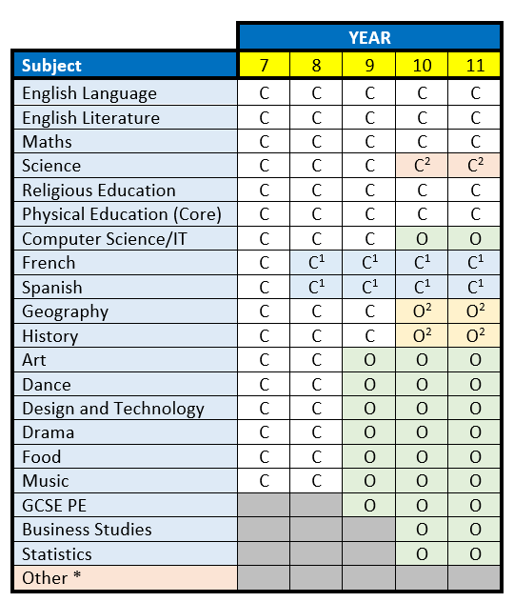

Slide 11
Year 9 - Core Curriculum
English (Language and Literature)
Maths
Science (Biology, Chemistry, Physics)
Geography
History
Computing
RE
PE (core)
MFL*

Slide 12
Year 9 – Optional subjects (Max 3)
Art
Dance
D & T
Drama
Food
Music
PE (theory)

Slide 13
Note:
If numbers are not viable, courses may not run
If a course is oversubscribed, a student’s commitment to the subject will be taken into account as well as the mix of other options chosen
Where possible, students will be allocated their first choices, but not all combinations will be possible

Slide 14
Year 10 & 11

Slide 15
GCSE’s
GCSEs prepare you for life in one of several pathways:
  Sixth Form
  Further Education at college
  Apprenticeship
  Employment
  Armed Forces
Most of you won’t have considered which pathway is best for you yet, and even if you have, may even change your mind at a later stage.
Your GCSEs are a stepping stone to the next chapter in your lives, making choices now that keep a range of options open is a perfectly normal and sensible decision.

Slide 16
GCSE’s – Y10 & 11
More rigorous – harder
Bigger – more content
Linear with terminal exam – little chance to resit
Except in a few subjects, there is no coursework
A new grading system
By focusing on subjects in more depth in Year 9, students have more time to prepare, both in terms of developing skills and in covering the content for the task ahead

Slide 17
Year 10 & 11 - Core Curriculum
English (Language and Literature)
Maths
Science (Biology, Chemistry, Physics)
History or Geography
Modern Foreign Language
RE
PE (core)
PSHE

Slide 18
Year 10 & 11 - Options
Towards the end of Year 9, students will be guided towards their final GCSE subjects based on the progress and potential they have shown during Year 9
Optional subjects for Year 10 and 11 will be confirmed towards the end of Year 9

Slide 19
Year 10 – Optional subjects (Max 2.5)
Computer Science
French
Spanish
Geography
History
Art
Dance
Design and Technology
Drama
Food
Music
Physical Education (GCSE)
Business Studies
Statistics
Other

Slide 20




Qualifications
GCSE Grades 9 – 1
Grade 5 – ‘strong’ pass
Grade 4 – ‘standard’ pass
VCert Pass / Merit / Distinction
BTEC Pass / Merit / Distinction

Slide 21
GCSE Grading
U
1
2
3
4
5
6
7
8
9
U
G
F
E
D
C
B
A
A
*

Slide 22
English Baccalaureate
Students who gain a strong pass (Grade 5+) in:
  English
  Maths
  Sciences (inc. Computer Science)
  Modern Foreign Language
  History or Geography
… will automatically gain the English Baccalaureate
Most students at MPA will be expected to continue studying Ebacc subjects in Year 10 and 11

Slide 23

Russell Group
Notes:
The Russell Group’s 24 members are world-class, research-intensive universities. They are unique institutions, each with their own history and ethos, but they share some distinguishing characteristics.
They produce more than two-thirds of the world-leading research produced in UK universities and support more than 260,000 jobs across the country.
They inject nearly £87 billion into the national economy every year.

Slide 24
Decision Time

Slide 25
Consider
What you are good at
What you enjoy
What will help you in the future
Where you want to be in 5 years / 10 years time
Asking your teachers for advice
Do aim for a broad and balanced curriculum – a variety of subjects

Slide 26
Do NOT Consider
Don’t choose a subject just because your friends are taking it
Don’t choose a subject just because you like your current teacher
Don’t choose too many similar subjects
Don’t choose a subject because you think it is an ‘easy option’ – there aren’t any!

Slide 27
Year 9 – Optional subjects (Max 3)
Art
Dance
D & T
Drama
Food
Music
PE (theory)

Slide 28
Note:
If numbers are not viable, courses may not run
If a course is oversubscribed, a student’s commitment to the subject will be taken into account as well as the mix of other options chosen
Where possible, students will be allocated their first choices, but not all combinations will be possible

Slide 29
Time
Your shouldn’t make up your mind straight away
Ask teachers if you are not sure about anything

Slide 30
Deadline
https://www.surveymonkey.co.uk/r/Y9OptionsMPA
Thursday 28 March 2024

Slide 31
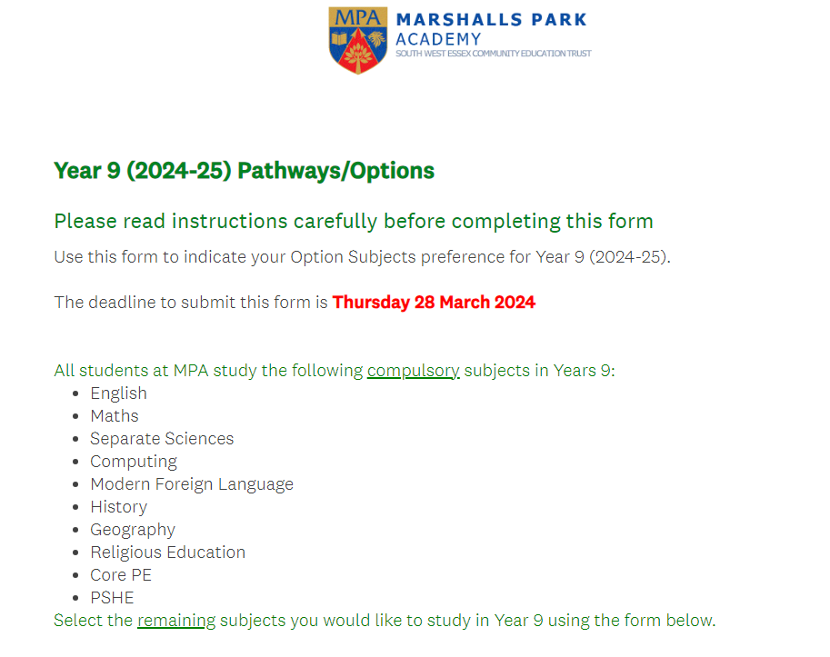

Slide 32
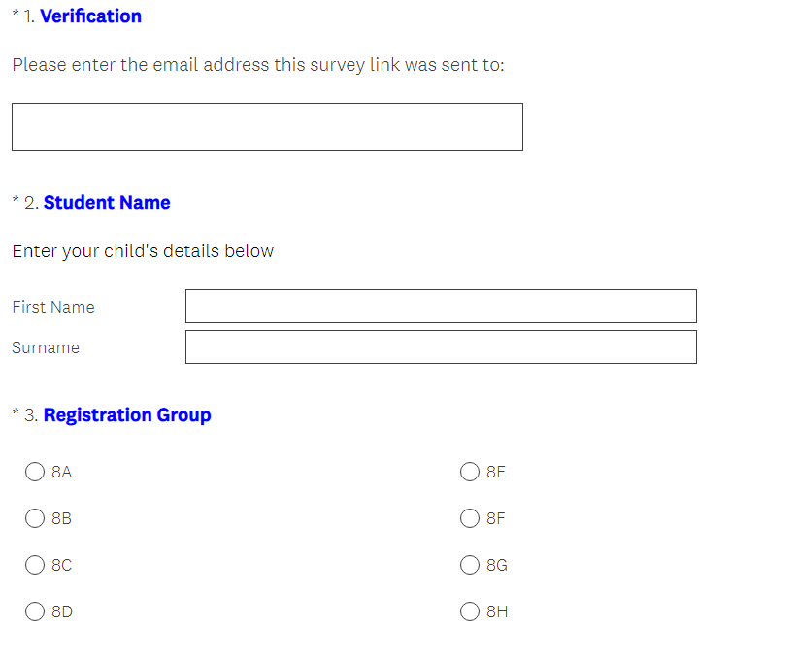

Slide 33
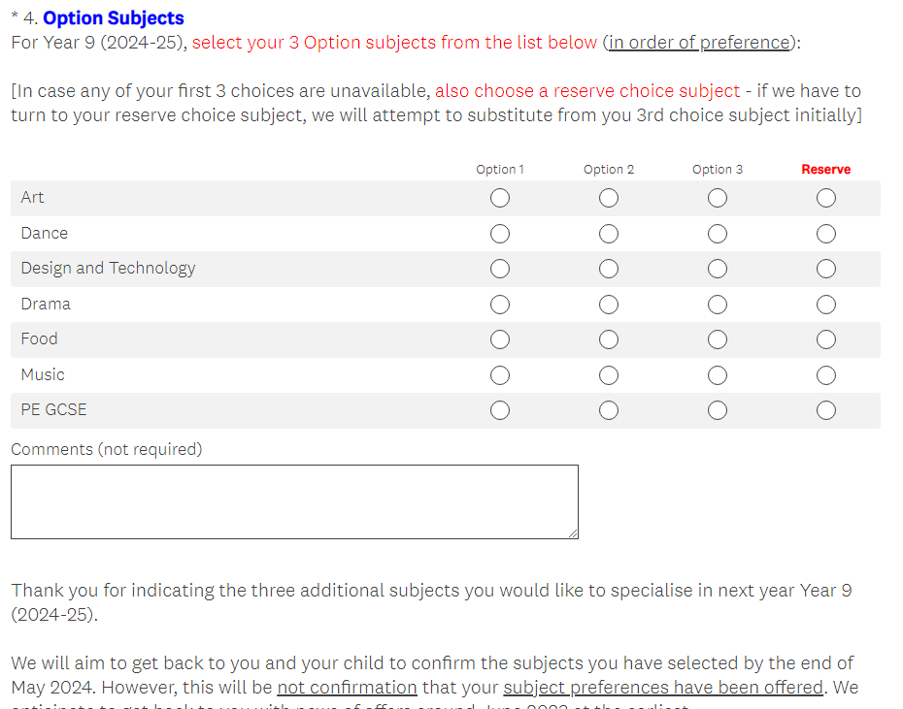

Slide 34
REMEMBER
Your choice of subjects, together with your performance and overall attitude to learning, will have an impact on your future

Slide 35
Still not sure?
Discuss choices with your parents, form tutor, and subject teachers in the first instance
If you are still unsure or have any further questions, email
pathways@mpa.swecet.org

Slide 36
Deadline
https://www.surveymonkey.co.uk/r/Y9OptionsMPA
Thursday 28 March 2024

Slide 37
Thank You

